Slide 1
Advanced Lab-2
OSD - PRACTICAL

Slide 2
The Outcomes of today’s lab are as follows--
Xv6 design, implementation, and customization. 1. TOUCH 2. TAIL
UNIX system programming
1. lseek: Positioning the Offset
2. Pointerreverse_read.c: Reading a File in Reverse
3. Run-Time Stack Usage in 32-Bit GCC

Slide 3
Touch Command examples:
Example 1: Create an empty file using touch
$ touch filename
Example 2: create multiple files
$ touch file1 file2 file3
Example 3: Change / Update access time of a file and directory
Let’s assume we want to change access time of a file called “example.txt“, to do this use ‘-a‘ option in touch command followed by file name, example is shown below,
$ touch –a example.txt
Now verify whether access time of a file has been updated or not using ‘stat’ command
$ stat example.txt

Slide 4
TOUCH COMMAND IN XV6:
#include"types.h"
#include "user.h"
#include "fcntl.h"
#include "fs.h"
int main(int argc,char *argv[])
{
if(argc<2)
{
printf(1,"Usage: touch [files]...\n");
exit();
}
int i,err;
for(i=1;i<argc;i++)
{
if((err=open(argv[i],O_CREATE|O_RDWR)) < 0)
{
printf(1,"touch: error where creating %s\n",argv[i]);
exit();
}
close(err);
}
exit();
}

Slide 5
Steps for execution:
Step 1: Open Makefile
Syntax: vi Makefile
Step 2: IN Makefile program do the following changes in two sections:
. UPROGS= \
_cat\
_echo\
_forktest\
_grep\
_init\
_kill\
_ln\
_ls\
_mkdir\
_rm\
_sh\
_stressfs\
_usertests\
_wc\
_zombie\
_touchex\
EXTRA= \ mkfs.c ulib.c user.h cat.c echo.c forktest.c grep.c kill.c\ ln.c ls.c mkdir.c rm.c stressfs.c usertests.c wc.c zombie.c\ touchex.c\
printf.c umalloc.c\ README dot-bochsrc *.pl toc.* runoff runoff1 runoff.list\ .gdbinit.tmpl gdbutil\

Slide 6
Enter the following commands to compile the whole system.
Syntax:
make clean
Make
Now, start xv6 system on QEMU and when it booted up, run ls command to check whether our program is available for the user.
Syntax:
make qemu-nox
$ ls
Check whether touchex is listed in the output.If yes then use that as a command.
$ touchex f1.txt
$ ls
The output should show f1.txt in the list of files.

Slide 7
Tail Command with examples:
The tail command, as the name implies, print the last N number of data of the given input. By default it prints the last 10 lines of the specified files. If more than one file name is provided, then data from each file is precedes by its file name.
$ tail filename.txt
Prints the last 10 lines from the given filename.
There are options that can be given along with the tail command like:
-n → prints the last n number of lines
$ tail –n 3 filename.txt
Prints the last three lines from the given filename.
$ tail +n filename.txt
Tail command also comes with an ‘+’ option which is not present in the head command. With this option tail command prints the data starting from specified line number of the file instead of end.

Slide 8
TAIL COMMAND IN XV6:
#include "stat.h"
#include “types.h”
#include "user.h"
#include "fcntl.h"
char buf [1024];
void tail (int fd, char *name, int line) {
int i, n; //here the size of the read chunk is defined by n, and i is used to keep a track of the chunk index
int l=0; // here total lines are defined by l, and the character count in the string is defined by c
int count = 0;
int temp = open ("temporary", O_CREATE | O_RDWR); // creating a temporary file to store the data/ user input in it then print it
while((n = read(fd, buf, sizeof(buf))) > 0 )
{
write (temp, buf, n); // writing the n chunks of data from buffer to the temp file
for(i=0;i<=n ;i++)
{
if(buf[i] != '\n') // checking for end of line, if so then conitnue
{
continue;
}

Slide 9
else // else count the number of lines in the file
{
l++;
}
}
}
close (temp);
if (n < 0)
{
printf(1, "tail: read error\n");
exit();
}
temp = open ("temporary", 0); // opening the file reading the file from the beginning
while((n = read(temp, buf, sizeof(buf))) > 0 )
{
for (i = 0; i<n; i++)
{
if (count >= (l - line)) // to check if the counter value exceeds the last n lines to be printed or not, if yes then print those lines
{
printf(1,"%c",buf[i]);
}
else if (l < line) // to check i fthe total number of lines in the file are less than the requested number of lines
{
printf(1,"%c",buf[i]);
}

Slide 10
else if (buf[i] == '\n') // to check for end of line in the buffer, to increase the count value
{
count++;
}
}
}
close (temp);
unlink("temporary"); // delete the file before closing the function
}
int
main(int argc, char *argv[]) {
int i;
int fd = 0; // when the file is not specified, then it will take input from the user
int x = 10; // will read the last 10 lines by default
char *file; // pointer to the name of the file
char a;
file = ""; // in the case when no file name is specified, it will take input from the user
if (argc <= 1)
{
tail(0, "", 10); // handles the default case of taking input from user and printing only last 10 lines
exit();
}

Slide 11
else {
for (i = 1; i < argc; i++)
{
a = *argv[i]; // assigns the char value of the argv to the var a
if (a == '-')
{ // it means that -NUM is provided, hence limited number of lines are to be printed
argv[i]++;
x = atoi(argv[i]++);
}
else
{ // if a !='-' then it implies that number of lines are not defined and hence default lines will print
if ((fd = open(argv[i], 0)) < 0)
{// this will execute if the file is unable to open
printf(1, "tail: cannot open %s\n", argv[i]);
exit();
}
}
}
tail(fd,file, x);
close(fd);
exit();
}
}

Slide 12
lseek: Positioning the Offset (17.8) (REFERENCE TEXT BOOK: SUMITABHA DAS)
lseek doesn’t do any physical I/O. It simply moves the file offset pointer to a specified
point where the next I/O operation will take place. Here’s its syntax:
off_t lseek(int fildes, off_t offset, int whence);
The offset and whence arguments together control the location of the file’s offset pointer.
offset signifies the position (positive or negative) of this pointer relative to whence, which
can take one of three values:
SEEK_SET Offset pointer set to beginning of file.
SEEK_END Offset pointer set to end of file.
SEEK_CUR Offset pointer remains at current location.

Slide 13
Example on lseek:
#include<sys/types.h>
#inlclude<sys/stat.h>
#include<fcntl.h>
#include<unistd.h>
int main()
{
int n,f,f1;
char buff[10];
f=open(“f1.txt”,O_RDWR);//1234567890abcdefghijx1x2x3x4x5
read(f,buff,10);//12345678904
write(1,buff,10);
lseek(f,10,SEEK_CUR);
read(f,buff,10);//x1x2x3x4x5
write(1,buff,10);
}
Execution steps :
open vi editor type the above program
Compile: gcc lseekex.c
./a.out

Slide 14
reverse_read.c Reading a File in Reverse(17.8.1)
You can’t read a file from the end to the beginning using the standard UNIX utilities
(except perl), but using lseek in a C program, reverse_read.c, you can.
You have to first move the file pointer to one character beyond EOF. Then use a loop to
move the pointer back by two positions every time a character is read.
Hence, we use a single-character buffer with read and write. While read advances the pointer one byte forward, the next lseek takes it back by two bytes.

Slide 15
reverse_read.c Reading a File in Reverse(17.8.1)
#include <fcntl.h>
#include <unistd.h> /* For STDOUT_FILENO */
#include <stdio.h>
int main(int argc, char **argv) {
int size, fd;
char buf; /* Single-character buffer */
char *mesg = "Single filename required\n";
if ((fd = open(argv[1], O_RDONLY)) == -1)
perror("open");
lseek(fd, 1, SEEK_END); /* Pointer taken to EOF + 1 first */
while (lseek(fd, -2, SEEK_CUR) >= 0) { /* and then back by
two bytes */
if (read(fd, &buf, 1) != 1)
perror("read");
if (write(STDOUT_FILENO, &buf, 1) != 1)
perror("write");
}
close(fd); /* Can have error here too */
exit(0); /* exit doesn't return - hence no error */
}
Execution:
open vi editor type the above program
Compile: gcc reverse_read.c
./a.out f1.txt

Slide 16
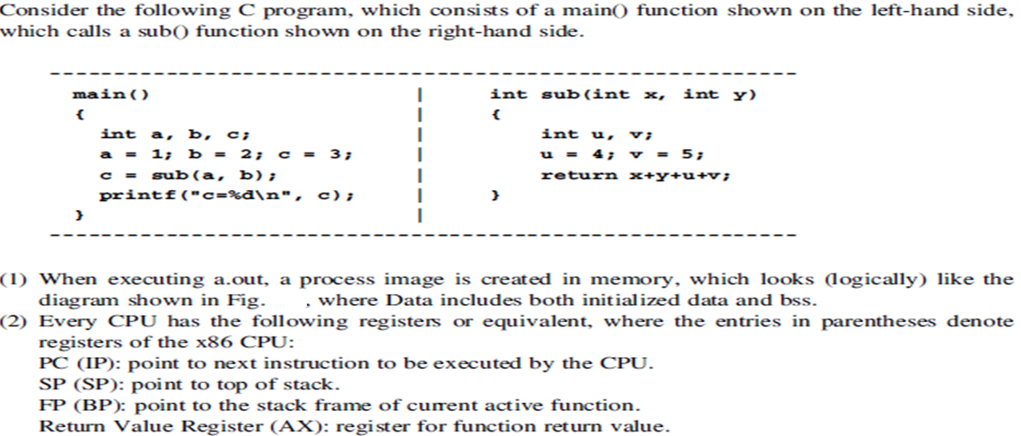
Run-Time Stack Usage in 32-Bit GCC(Reference Book: K.C Wang System Programming in Unix/Linux)

Slide 17
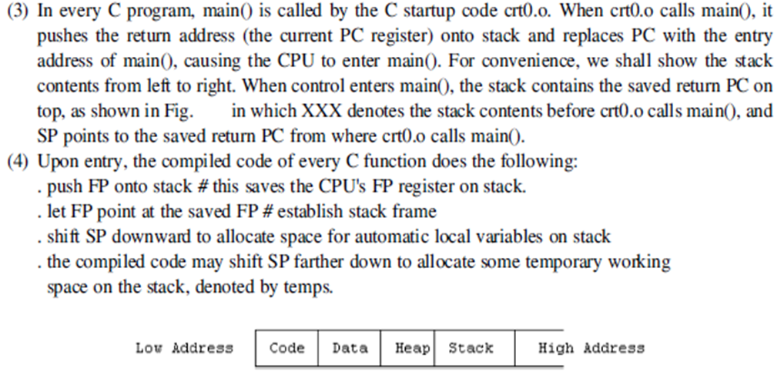

Slide 18
Thank You

